Slide 1


CS-446: Information Systems Security
Lecture # 2: Introduction to Cryptography and Classical Cryptography
Prof. Dr. Sufian Hameed
Department of Computer Science
FAST-NUCES

Slide 2
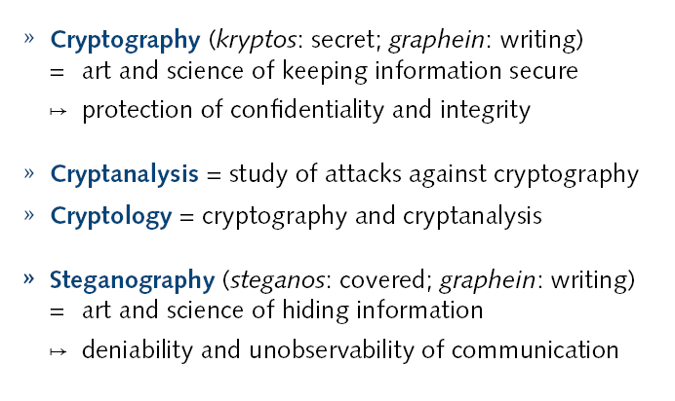
Cryptography

Slide 3
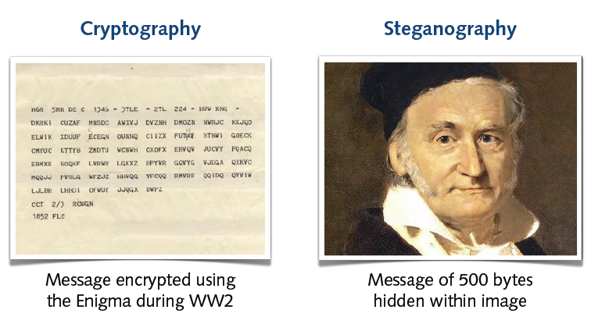
Examples

Slide 4
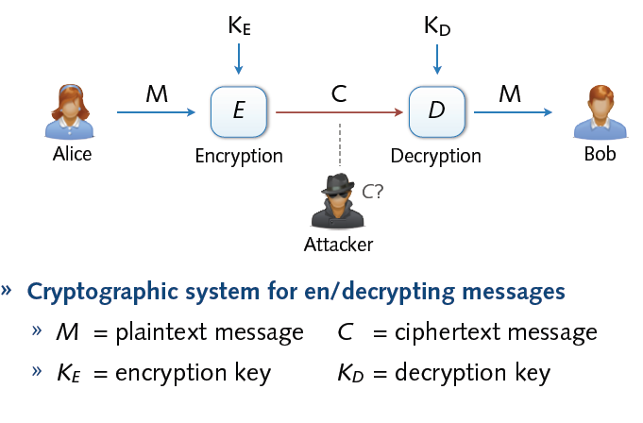
Cryptosystem

Slide 5
Attacks against Cryptosystems
1.) Cipher text-only: Attacker possesses a string y of the cipher text
2.) Known plaintext: Attacker possesses a string x of the plaintext and the corresponding cipher text y. The problem now is to find out the key which produces y from x
3.) Chosen plaintext: Attacker has access to the encryption machinery. Hence he can chose a plaintext string x and construct the corresponding cipher text string y.
4.) Chosen cipher text: Attacker has access to the decryption machinery. Hence, he can chose a cipher text string y and construct the corresponding plaintext string x.

Slide 6
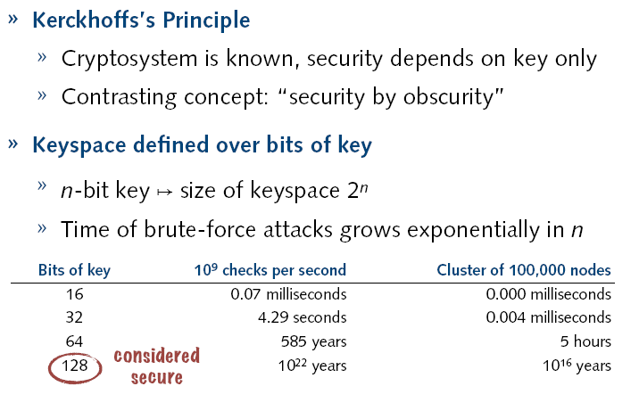
Security of Keys

Slide 7
Cryptography is everywhere
Secure communication:
web traffic: HTTPS
wireless traffic: 802.11i WPA2 (and WEP), GSM, Bluetooth
Encrypting files on disk:
EFS (Encrypting File System)
TrueCrypt (open-source disk encryption software)
Content protection
DVD --- Content Scramble System (CSS) is a Digital Rights Management (DRM) and encryption system employed on almost all commercially produced DVD-Video
Easy to break
Blu-Ray --- Advance Access Content System (AACS)
User authentication
… and much much more

Slide 8
Things to remember
Cryptography is:
A tremendous tool
The basis for many security mechanisms
Cryptography is not:
The solution to all security problems
Software bugs
Social engineering attacks
Reliable unless implemented and used properly
Wired Equivalent Privacy (WEP -- good example on how not to use cryptography)
Something you should try to invent yourself
many examples of broken ad-hoc designs
Propriety ciphers, once re-engineered are easily broken

Slide 9
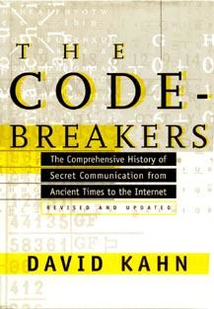
History
David Kahn, “The code breakers” (1996)

Slide 10
Historical Cryptosystems
Monoalphabetic cipher: Each alphabetic character is mapped onto a unique alphabetic character
Examples: Shift Cipher, Substitution Cipher, Affine Cipher
Polyalphabetic cipher: Each alphabetic character is mapped onto various alphabetic characters
Examples: Vigenere Cipher, Hill Cipher, Permutation Cipher

Slide 11
Symmetric Cryptosystems
Formal Definition:
Cryptosystem is defined over (K,M,C) and a pair of “efficient” algorithms (E, D) s.t.
∀ m∈M, k∈K and c∈C : E(k, m) = c, D(k, E(k, m) ) = m
Efficient means run in polynomial time
Notes:
Picture of cipher

Slide 12
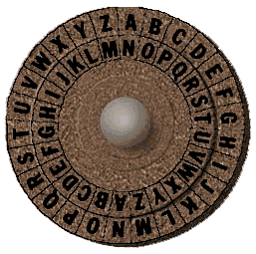
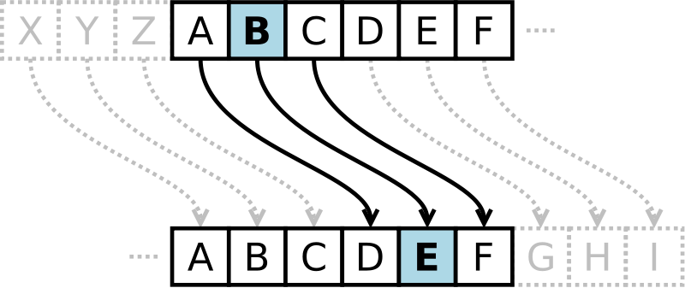
Shift Cipher
Cipher in which each letter in the plaintext is replaced by a letter some fixed number of positions down the alphabet. Example includes Ceasar cipher, ROT13
Ceasar Cipher
Each letter is replaced with a fixed shift of 3 letters
Example of Ceasar cipher using left rotation of 3 places
Plain: ABCDEFGHIJKLMNOPQRSTUVWXYZ
Cipher: DEFGHIJKLMNOPQRSTUVWXYZABC
Source: wikipedia

Slide 13
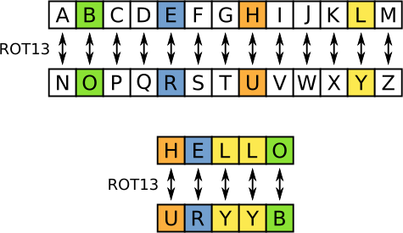
Shift Cipher (ROT13)
ROT13
Each letter is replaced with a fixed shift of 13 letters
The transformation can be done as follows
Plain: ABCDEFGHIJKLMNOPQRSTUVWXYZ
Cipher: NOPQRSTUVWXYZABCDEFGHIJKLM
Modular arithmetic representation:
Encryption of a letter x by a shift n can be described mathematically as
E_{n}(x) = (x+n) mod 26
Decryption is performed in a similar manner
D_{n}(x) = (x-n) mod 26
Key space is ridiculously small, very easy to break
Source: wikipedia

Slide 14
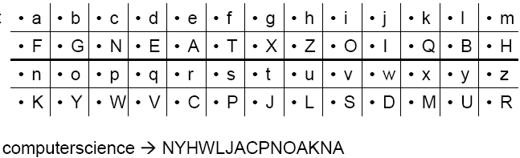
Substitution Cipher
Idea: use a permutation over the set of characters as key to get a more flexible scheme as in the shift cipher
Keyspace significantly larger
Character frequencies are preserved

Slide 15




What is the size of key space in the substitution cipher assuming 26 letters?
$$|\text{𝒦}\text{| = 26}$$
$\left|𝒦\right|=26! ($26 factorial)
$$|\text{𝒦}\text{| = }2^{26}$$
$$|\text{𝒦}\text{| = }{26}^{2}$$

Slide 16
Breaking Monoalphabetic Ciphers
Monoalphabetic ciphers preserve the frequency of alphabetic characters, pairs, etc.
→ Identify alphabetic characters due to their frequency
Method to decipher natural languages:
Determine frequency of alphabetic characters of the cipher text
Identify alphabetic characters according to their frequency: e, n, i, s, r, a, t (in Germany: e, n, r, i, s, t, u, d, a, g, l, o, ...)
Determine frequency of pairs
Identify e.g. th he
Look at identified text, re-substitute, guess, ...

Slide 17
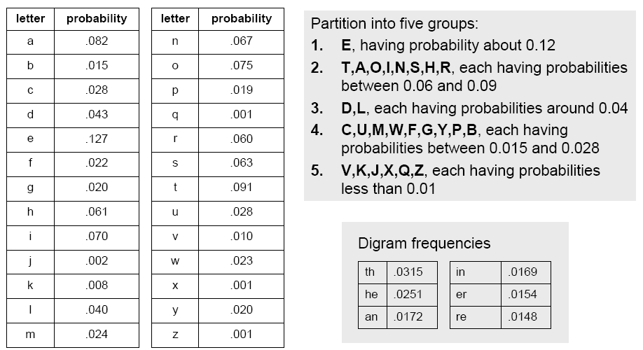
Breaking Monoalphabetic Ciphers

Slide 18
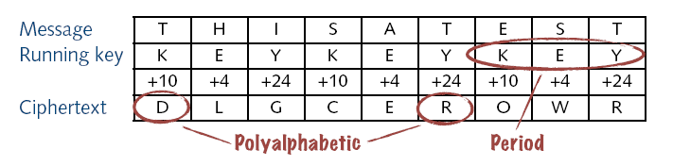
Vigenere Cipher
Popular polyalphabetic substitution cipher
Known as “le chiffre indéchiffrable” (‘the indecipherable cipher’ );-)
Combination of simple substitution ciphers
Rotations determined by a word (key)
A B C D E F G H I J K L M N O P Q R S T U V W X Y Z
0 1 2 3 4 5 6 7 8 9 10 11 12 13 14 15 16 17 18 19 20 21 22 23 24 25

Slide 19
Breaking Vigenere Cipher
Frequency analysis trivial if period can be guessed
Kasiski test
Repeated words may, by chance, sometimes be encrypted using the same key letters, leading to repeated groups in the ciphertext
Consider the following encryption using the keyword ABCD
Key: ABCD ABCD ABCD ABCD ABCD ABCD ABCD
Plaintext: CRYP TOIS SHOR TFOR CRYP TOGR APHY
Ciphertext: CSAS TPKV SIQU TGQU CSAS TPIU AQJB
Repetitions of CSASTP is at a distance16
Assuming that the repeated segments represent the same plaintext segments, this implies that the key is 16, 8, 4, 2, or 1 characters long
Source: wikipedia

Slide 20
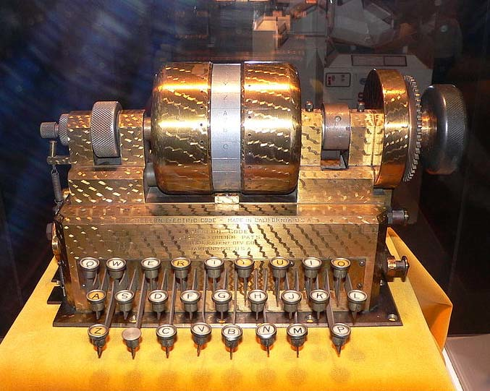
Rotor Machines (1870-1943)
The Hebern Machine (single rotor)
Easily broken (CT only) using letter frequency, diagram frequency, trigram frequency
A
B
C
.
.
X
Y
Z
K
S
T
.
.
R
N
E
E
K
S
T
.
.
R
N
N
E
K
S
T
.
.
R
key

Slide 21
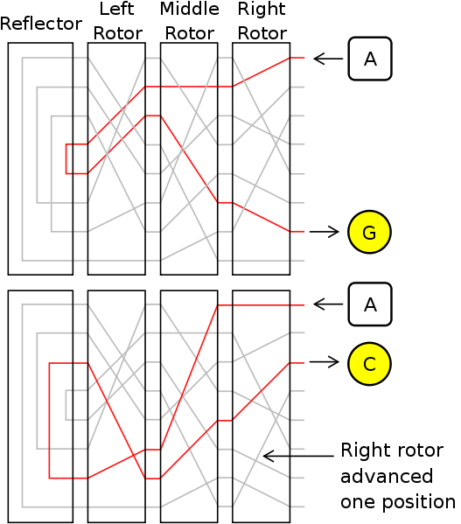
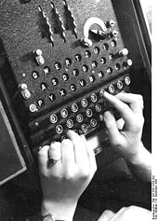
Rotor Machines (cont.)
Most famous: the Enigma (3-5 rotors)
With 4 rotors keys = 26⁴ = 2¹⁸ (actually 2³⁶ due to optional plugboard)

Slide 22
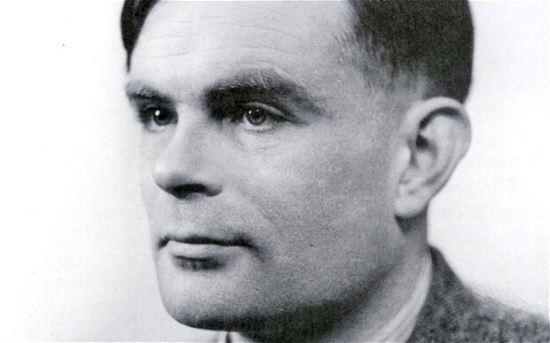
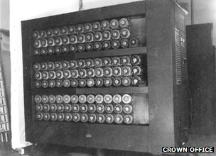
Turing Bombe

Slide 23
Must watch
“The Man Who Cracked Enigma”

Slide 24
Acknowledgements
Material in this lecture are taken from the slides prepared by:
Prof. Dr. Konrad Rieck (Uni-Göttingen)
Prof. Dan Boneh (Stanford)

